Slide 1

Chapter 1 ~ The Origin of Digital Image Processing
Heaven’s Light is Our Guide
Department of Computer Science & Engineering
Rajshahi University of Engineering & Technology, Rajshahi-6204, Bangladesh.
S. M. Mahedy Hasan
Assistant Professor, Dept. of CSE
RUET, Rajshahi-6204, Bangladesh.

Slide 2
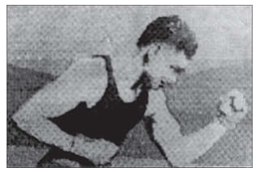
The Origins of Digital Image Processing
Early 1920s: One of the first applications of digital imaging was in the newspaper industry.
The Bartlane cable picture transmission service.
Images were transferred by submarine cable between London and New York.
Pictures were coded for cable transfer and reconstructed at the receiving end on a telegraph printer.
In that image, there were only 5 tones or discrete intensity levels.
Figure 1: A digital picture produced in 1921 from a coded tape by a telegraph printer with special typefaces.

Slide 3
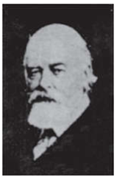
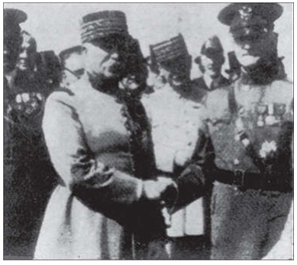
The Origins of Digital Image Processing
Mid to late 1920s: Improvements to the Bartlane system resulted in higher quality images.
New reproduction processes based on photographic techniques.
Increased number of tones in reproduced images.
There were 15 tones/ discrete intensity levels.
Figure 1: A digital picture made in 1922 from a tape punched after the signals had crossed the Atlantic twice.
Figure 3: Unretouched cable picture of Generals Pershing (right) and Foch, transmitted in 1929 from London to New York by 15-tone equipment.

Slide 4
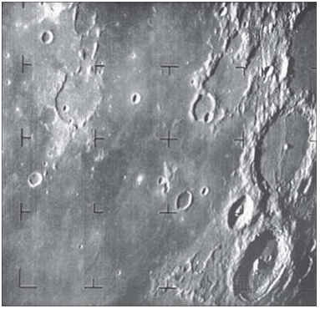
The Origins of Digital Image Processing
1960s: Improvements in computing technology and the onset of the space race led to a surge of work in digital image processing.
1964: Computers used to improve the quality of images of the moon taken by the Ranger 7 probe.
Such techniques were used in other space missions including the Apollo landings.
Figure 4: The first picture of the moon by a U.S. spacecraft. Ranger 7 took this image on July 31, 1964 at 9:09 A.M. EDT, about 17 minutes before impacting the lunar surface.

Slide 5
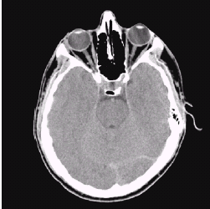
The Origins of Digital Image Processing
1970s: Digital image processing begins to be used in medical applications
1979: Sir Godfrey N. Hounsfield & Prof. Allan M. Cormack share the Nobel Prize in medicine for the invention of tomography, the technology behind Computerised Axial Tomography (CAT) scans.
It is interesting to note that X-rays were discovered in 1895 by Wilhelm Conrad Roentgen, for which he received the 1901 Nobel Prize for Physics. These two inventions, nearly 100 years apart, led to some of the most important applications of image processing today.
Typical head slice CAT image

Slide 6
The Origins of Digital Image Processing
1980s: The use of digital image processing techniques has exploded and they are now used for all kinds of tasks and in all kinds of areas.
Image enhancement
Image restoration
Artistic effects
Medical visualization
Industrial inspection
Law enforcement
Human computer interfaces

Slide 7
Examples of Fields that uses DIP (Sources of Images)
Electromagnetic (EM) energy spectrum
Acoustic
Ultrasonic
Electronic
Synthetic images produced by computer

Slide 8
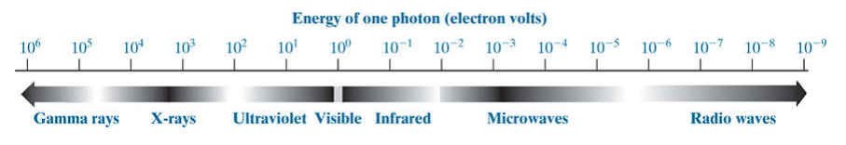
Electromagnetic (EM) energy spectrum
Major uses
Gamma-ray imaging: Nuclear medicine and astronomical observations.
X-rays: Medical diagnostics, industrial inspection, microscopy, lasers, biological imaging, and astronomical observations.
Ultraviolet and infrared bands: light microscopy, astronomy, remote sensing, industry, and law enforcement.
Microwave band: Radar.
Radio band: medical ( such as MRI) and astronomy.

Slide 9
Examples of Gamma-ray Imaging
Nuclear Medicine
The approach is to inject a patient with a radioactive isotope that emits gamma rays as it decays.
Images are produced from the emissions collected by gamma ray detectors.
Positron Emission Tomography (PET)
However, instead of using an external source of X-ray energy, the patient is given a radioactive isotope that emits positrons as it decays.
When a positron meets an electron, both are annihilated and two gamma rays are given off.
These are detected and a tomography image is created using the basic principles of tomography.

Slide 10
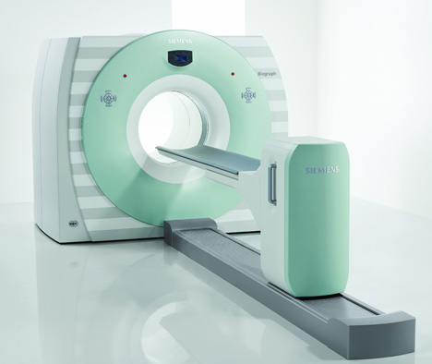
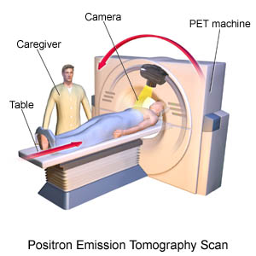
Examples of Gamma-ray Imaging
In nuclear medicine, the approach is to inject a patient with a radioactive isotope that emits gamma rays as it decays. Images are produced from the emissions collected by gamma ray detectors.
Figure 5: Biography: True Point 16-slice PET-CT from Siemens

Slide 11
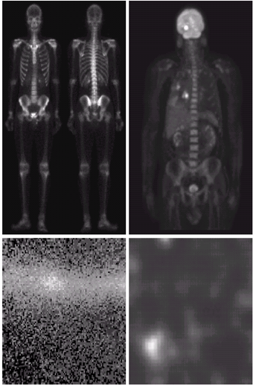
Examples of Gamma-ray Imaging
Bone Scan (Images of this sort are used to locate sites of bone pathology, such as infections or tumors). | Positron Emission Tomography (PET) image (This image shows a tumor in the brain and one in the lung, easily visible as small white masses).
Cygnus Loop | Gamma Radiation from a reactor valve (An area of strong radiation is seen in the lower left side of the image).

Slide 12
Examples of X-ray Imaging
X-rays for medical and industrial imaging are generated using an X-ray tube, which is a vacuum tube with a cathode and anode.
The cathode is heated, causing free electrons to be released. These electrons flow at high speed to the positively charged anode.
When the electrons strike a nucleus, energy is released in the form of X-ray radiation.
The energy (penetrating power) of X-rays is controlled by a voltage applied across the anode, and by a current applied to the filament in the cathode.

Slide 13
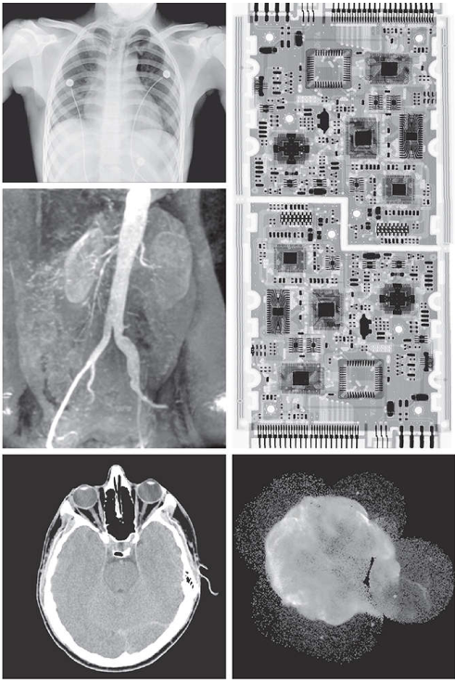
Examples of X-ray Imaging
Chest X-ray is used to identify the fractures in the bone.
Angiography is used to identify the irregularities in the blood vessel, where X-ray contrast medium is injected through catheter to enhance the contrast at site to be studied.
Used for CAT scans.
X-Ray image of a circuit board to identify the flaws in manufacturing.
Figure 5: Examples of X-ray imaging. (a) Chest X-ray. (b) Aortic angiogram. (c) Head CT. (d) Circuit boards. (e) Cygnus Loop.

Slide 14
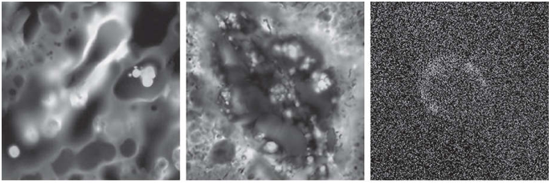
Examples of Ultraviolet Imaging
Used for lithography, industrial inspection, flouroescence microscopy, lasers, biological imaging and astronomy.
Figure 6: Examples of ultraviolet imaging. (a) Normal corn. (b) Corn infected by smut. (c) Cygnus Loop.

Slide 15
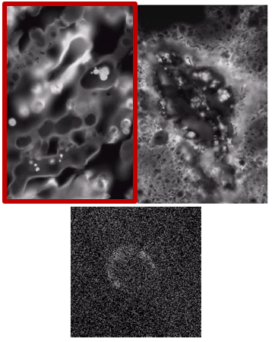
Examples of Ultraviolet Imaging
Figure 6(a) shows a fluorescence microscope image of normal corn.

Slide 16
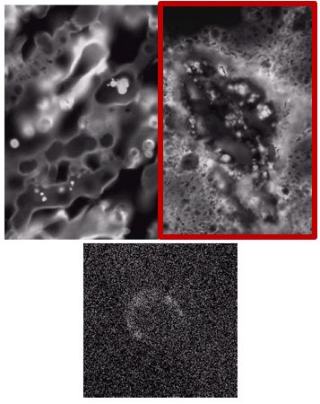
Examples of Ultraviolet Imaging
Figure 6(b) shows corn infected by “smut,” a disease of cereals, corn, grasses, onions, and sorghum that can be caused by any of more than 700 species of parasitic fungi.

Slide 17
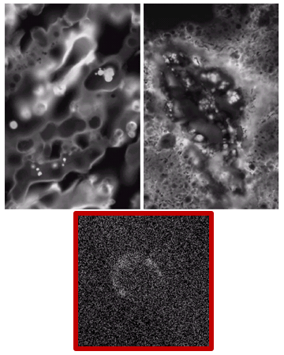
Examples of Ultraviolet Imaging
Figure 6(c) shows the Cygnus Loop imaged in the high-energy region of the ultraviolet band.

Slide 18
Visible and Infrared Imaging
Used for light microscopy, astronomy, remote sensing, law enforcement, industrial inspection.

Slide 19
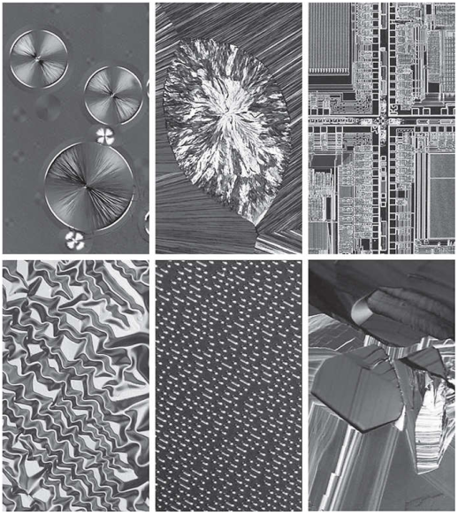
Visible and Infrared Imaging (Light Microscopy)
Taxol (Anticancer agent) | Cholesterol | Microprocessor
Nikel oxide | Surface of audio CD | Organic superconductor

Slide 20
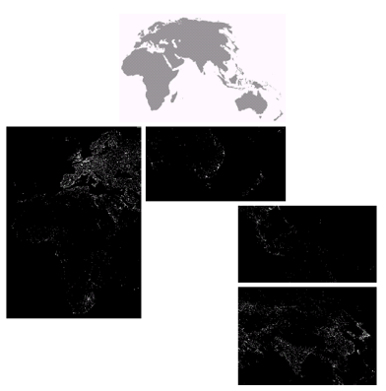
Examples of satellite Infrared Imaging
These images are part of the Nighttime Lights of the World data set, which provides a global inventory of human settlements.
The infrared imaging system operates in the band 10.0 to µm, and has the unique capability to observe faint sources of visible near infrared emissions present on the Earth’s surface, including cities, towns, villages, gas flares, and fires.

Slide 21
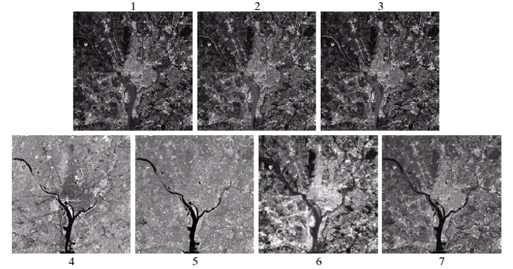
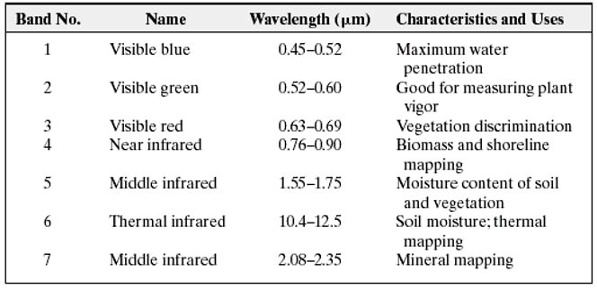
Examples of satellite Infrared Imaging
Figure 8: LANDSAT satellite images of the Washington, D.C. area.
Figure 9: Thematic band’s in NASA’s LANDSAT satellite

Slide 22
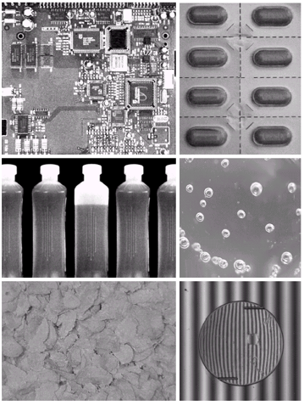
Examples of Some Applications
A circuit board controller (to inspect them for missing parts). | Packaged pills (look for missing pills).
Bottles (not filled up to an acceptable level). | Bubbles in clear-plastic product (Detecting anomalies like these is a major theme of industrial inspection).
Cereal (inspection for color and the presence of anomalies such as burned flakes). | Incorrectly manufactured replacement lens for eyes.

Slide 23
Microwave Band Imaging
The dominant application of imaging in the microwave band is radar.
The unique feature of imaging radar is its ability to collect data over virtually any region at any time, regardless of weather or ambient lighting conditions.
Radar used microwave pulses in order to illuminate the scene.
Antenna receives reflected microwave energy and this is recorded by a digital computer.
Radar can penetrate through clouds, ice, vegetation etc.

Slide 24
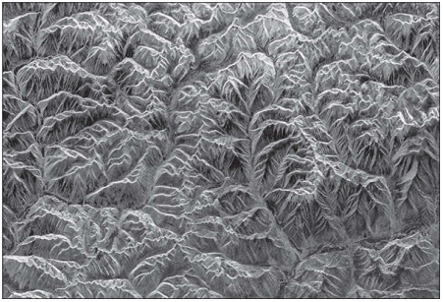
Example of Microwave Band Imaging
The following figure shows a spaceborne radar image covering a rugged mountainous area of southeast Tibet, about 90 km east of the city of Lhasa.
Figure 10: Spaceborne radar image of mountainous region in southeast Tibet.

Slide 25
Radio Band Imaging
It is widely used in medicine and astronomy.
In medicine, radio waves are used in magnetic resonance imaging (MRI).
This technique places a patient in a powerful magnet and passes radio waves through his or her body in short pulses.
Each pulse causes a responding pulse of radio waves to be emitted by the patient’s tissues.
The location from which these signals originate and their strength are determined by a computer, which produces a two-dimensional picture of a section of the patient.

Slide 26
Thank You ☺

